Slide 1
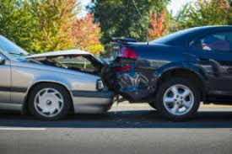
What To do After Car Accident?
If you or your loved one is injured in an automobile accidents or car crash, first seek medical treatment. Do not say anything at the scene of the accident – even if you believe you are at least partially at fault – since this may harm your potential case should you decide to seek damages. Obtain contact information from other parties involved in the accident and any witnesses, and take pictures of the accident scene. Following are the detailed steps one should follow after a car accident.

Slide 2
Steps That Might Help You After a Car Collision
1. Check Injuries
2. Collect Evidence
3. Exchange Information
4. Contact the Insurance Company
5. Hire a Car Accident Lawyer

Slide 3
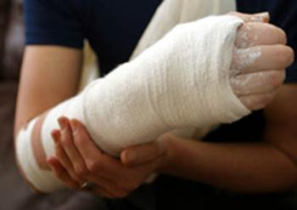
Check Injuries
After a car accident, the first thing to do is check your injuries and then check the passenger or whoever is with you. If you or the passenger are seriously injured, try not to move and call the Ambulance or 911 or ask someone nearby to help you. If you are able to move then get yourself to safety by moving away from the accident place.

Slide 4
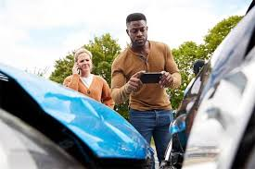
Collect Evidence
If you are able to move then it is good to Take photographs of the accident scene. It may help as an important evidence in future But if you can’t move due to safety concerns then take the photographs of the damage to each vehicle after visiting the doctor.

Slide 5
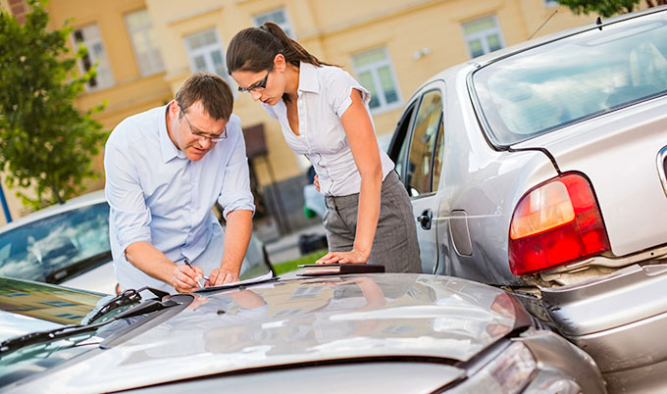
Stay Calm and don’t blame other drivers for accidents and also don’t apologize for the accident. Accident Lawyer in California advised you to Exchange the following information with another driver: Full Name, Address, and Mobile Number Insurance Company and policy number Driver’s Liscence Model name, and color of vehicle Accident Location
Exchange Information

Slide 6
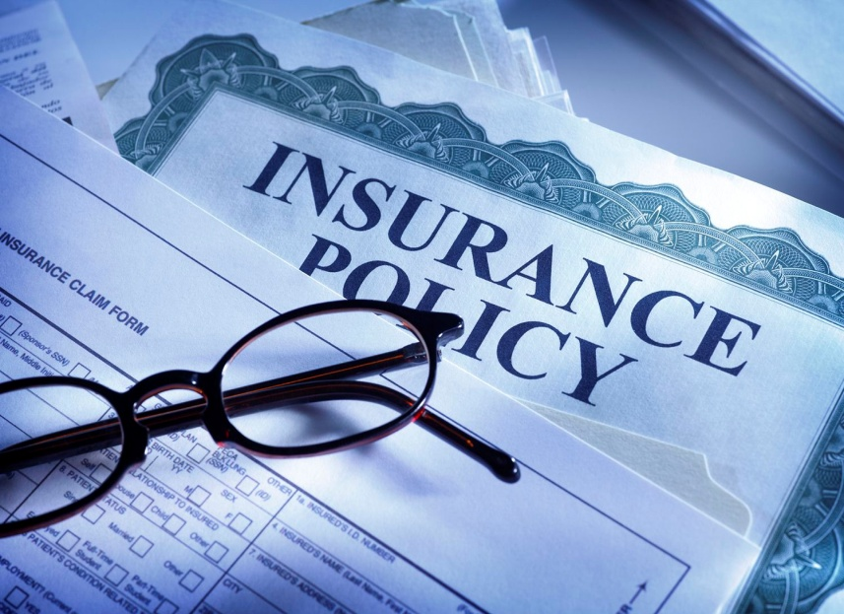
Contact Your Insurance Company
The next step is to contact the right party, Inform the other person’s insurance company that you have been in an accident with one of their policyholders. Give them the facts that their driver is at fault and liable to your damages.

Slide 7
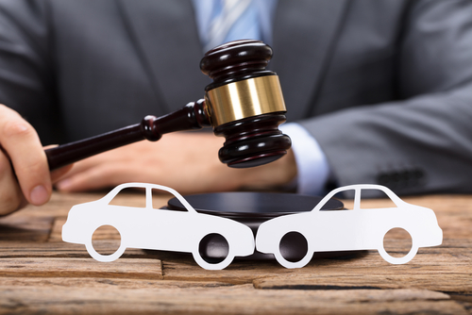
Hire a Car Accident Lawyer
After the accident, you have to deal with insurance companies and car repairs also. It is a time-consuming task. So, It’s better to leave the documentation work to a lawyer. An experienced CAR ACCIDENT LAWYER will help you in dealing with insurance companies and processing your claim.

Slide 8
Contact Us
Visit here: https://www.yorklawcorp.com
Phone Number: 800-939-1832
Email: info@yorklawcorp.com

